Slide 1
Preliminary Usability Test Results Presentation
Team 3: Green Stormwater Infrastructure UX Consultant : Aakash Gunda

Slide 2
Usability Test Process
Testing Method: In person at Library
Here’s a detailed outline of the usability testing process:
1) Extend a warm welcome to the participant, creating a comfortable and relaxed environment.
2) Provide a brief overview of the application and explain the goals of the usability test.
3) Verify that the participant has reviewed the consent form prior to beginning the test.
4) Have the participant complete the Pre-test Questionnaire.
5) Explain the test scenarios to the participant and begin each scenario.
6) Conducted a semi-structured interviews to ask questions related to each scenario.
7) After experiment, ask the participant to fill out the Post-test Questions and the Bug Report Form.
8) Express gratitude to the participant for their time and contributions.

Slide 3
Pre-Test Questionnaire Results
Tests Conducted: 8 Options Provided : Yes or No
&
Agree or Disagree
Questions Asked
1)How well are you comfortable using the mobile/Laptop?
All are Strongly Agreed
2)Do you have any prior knowledge about Green Spaces?
All are Neutral except one agree
3)Do you have any prior experience in testing applications?
5 Answered yes , 3 Answered No
4)How comfortable are you in testing GSI application ?
All are Strongly Agreed

Slide 4
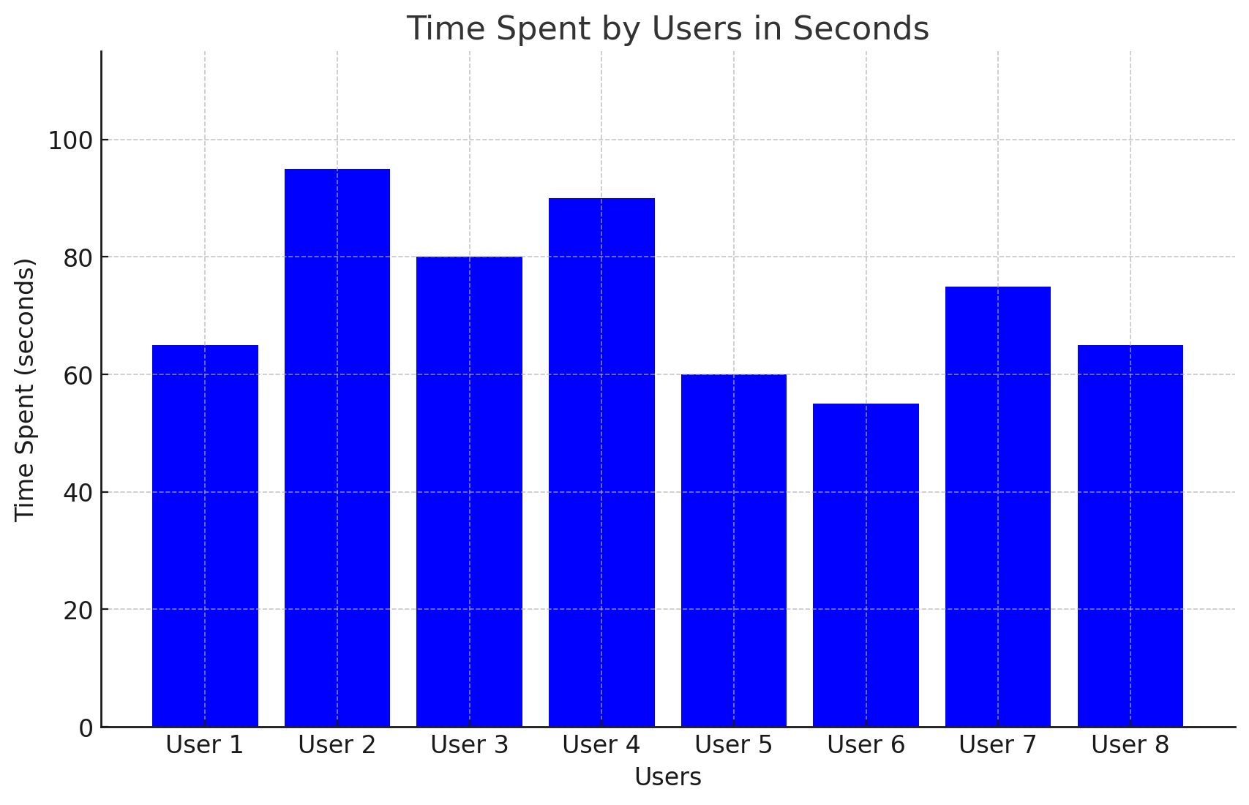
Test Scenario -1
Action Participants were asked to access the website and try to use the Home , Map , Contact & About Pages.
Questions Asked
Was Navigation between pages easy ?
Was content provided comfortable to read?
Qualitative Measurement
Time spent on the Page

Slide 5
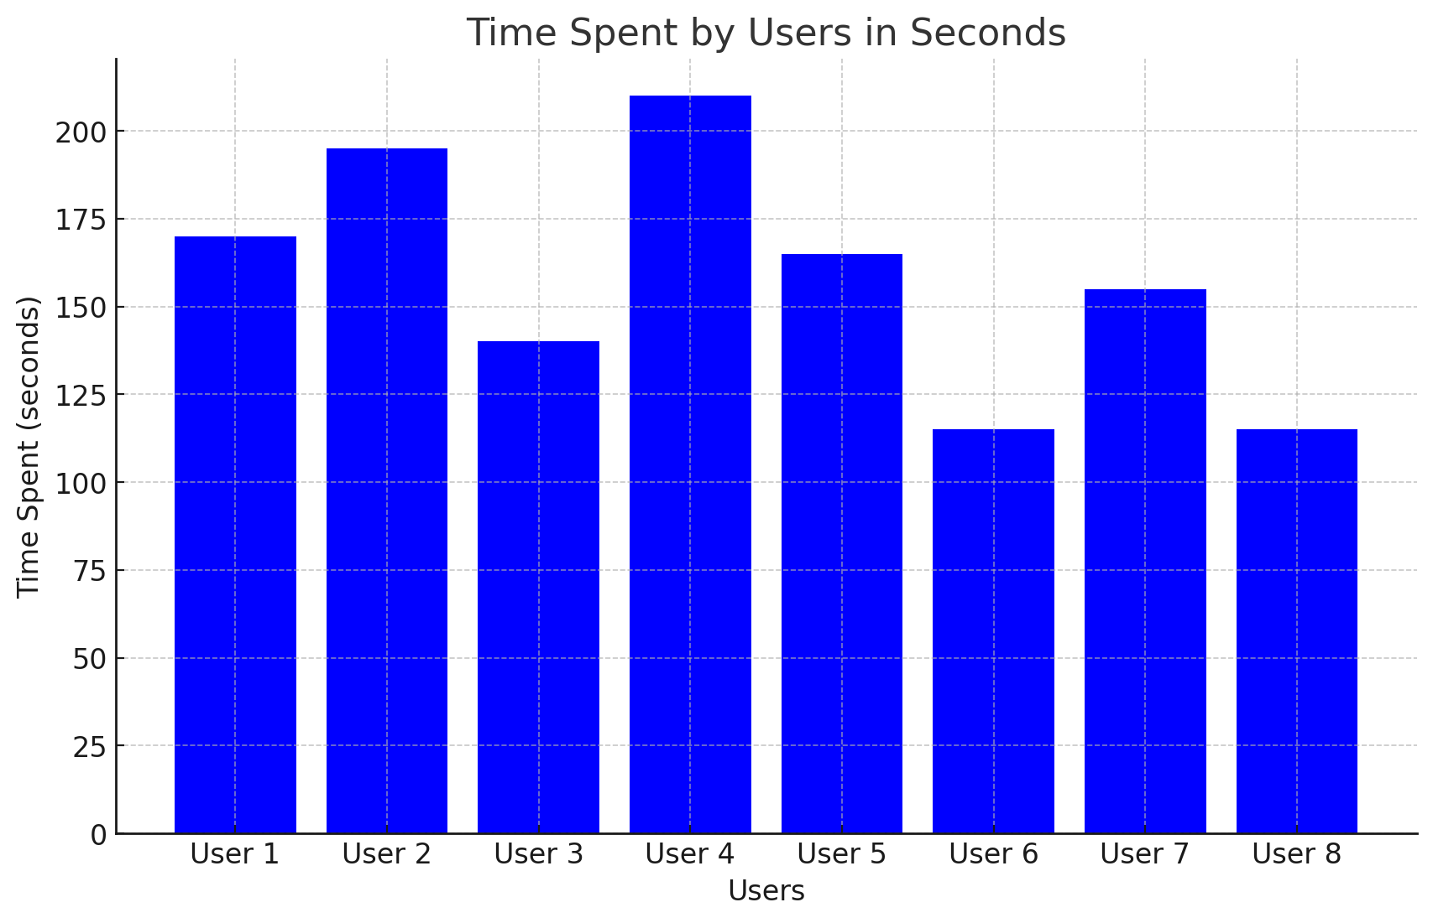
Test Scenario -2
Action Participants were asked to use the Map feature and create a new GSI location on the map and see it in the View Posts Tab.
Questions Asked How Comfortable did you feel while using the map feature? Are there any suggestions for enhancing the website or any pages?
Qualitative Measurement
Time spent on the Page

Slide 6
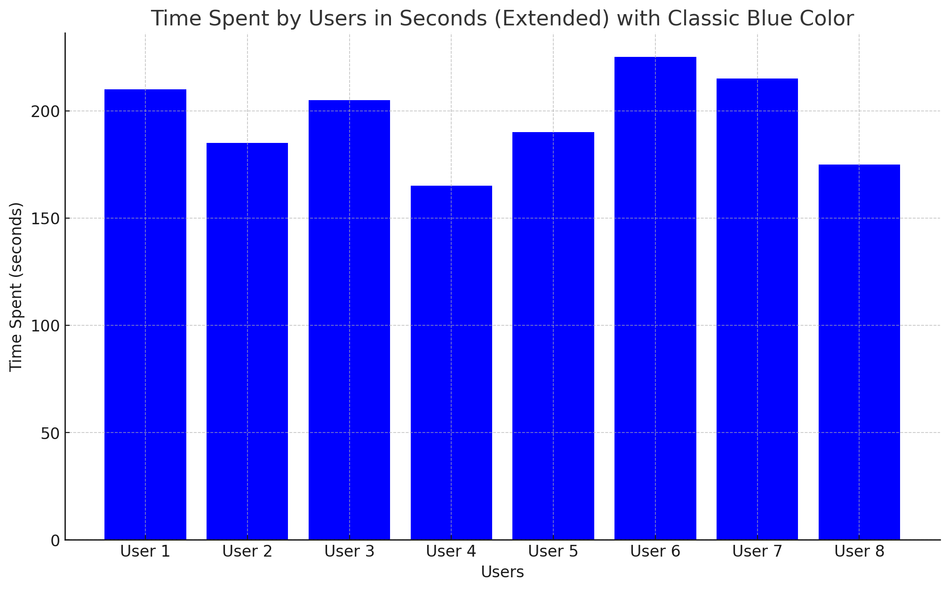
Test Scenario -3
Action User was asked to manipulate the existing posts and create user credentials for new users(Students)
Questions Asked
How comfortable were you while adding/deleting the accesses?
Do you have any recommendations for enhancing the website?
Quantitative measurement:
Time Spent adding or editing the post.
Time spent on adding or deleting the user credentials.

Slide 7
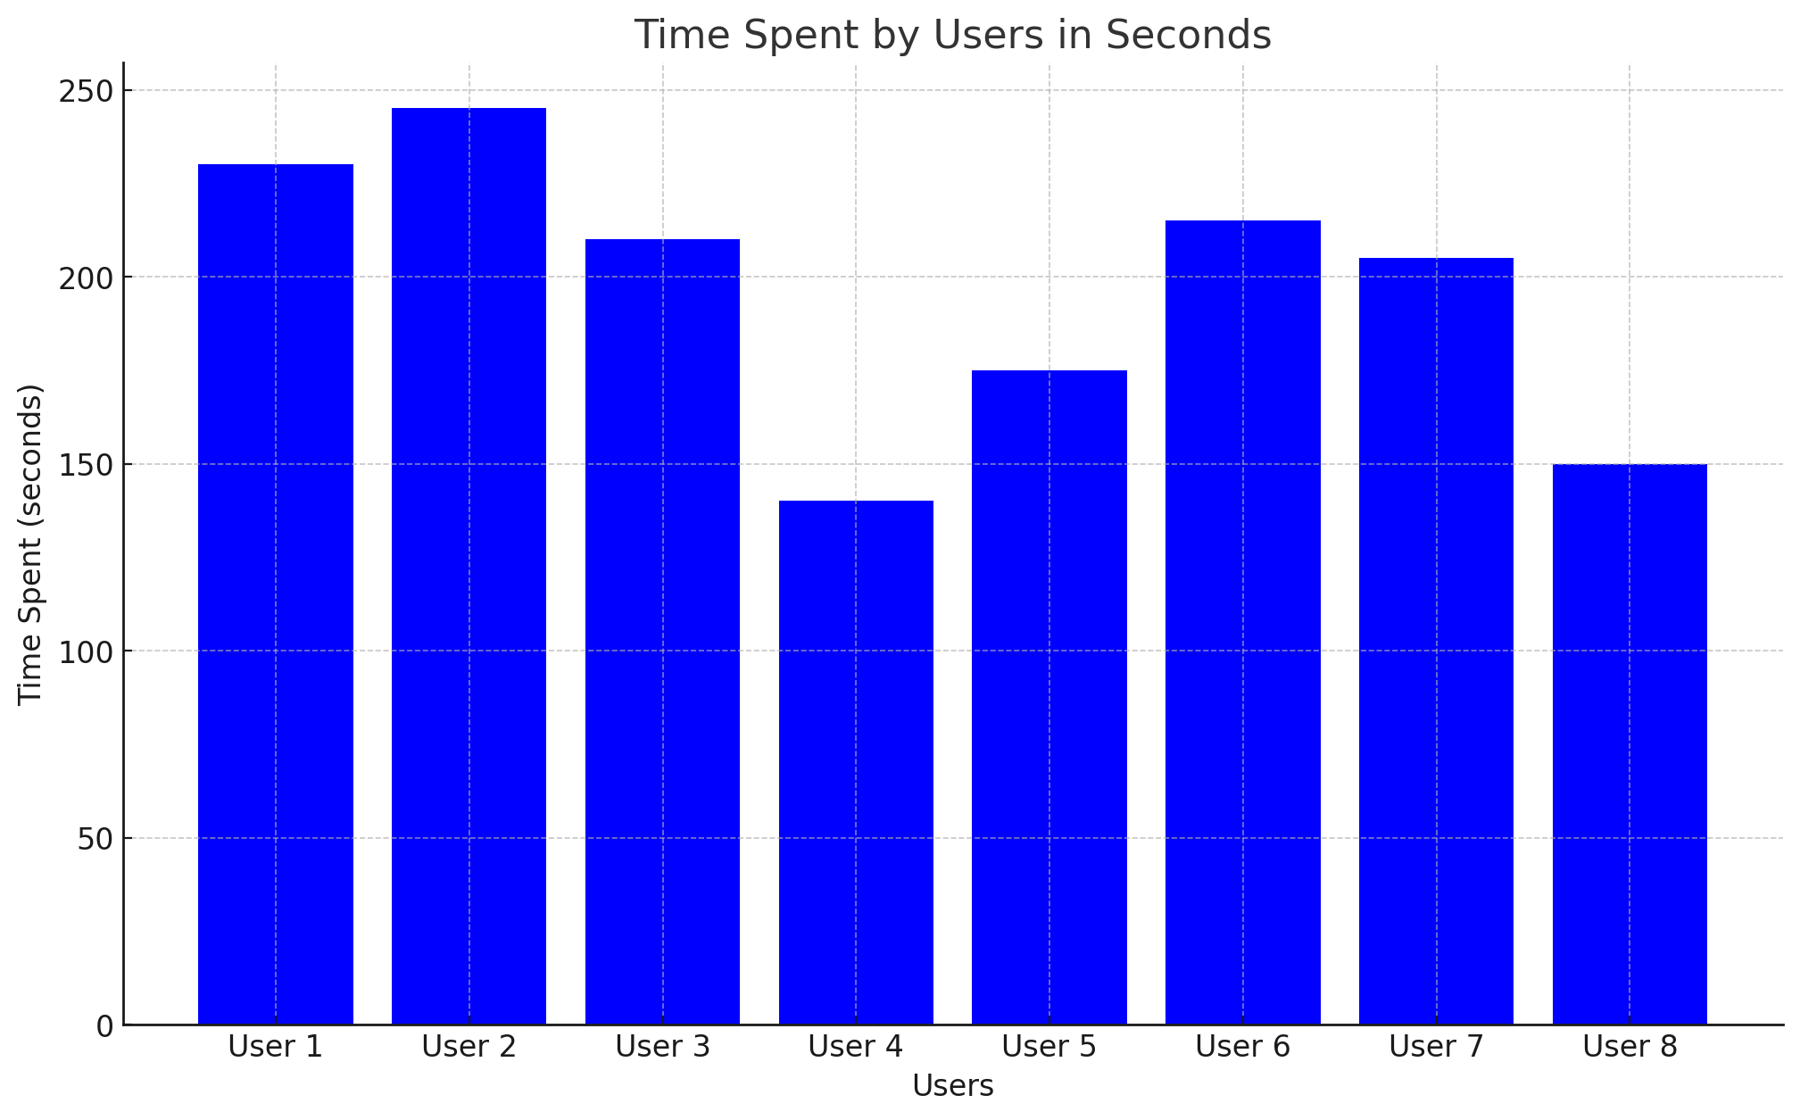
Test Scenario -4
Action User was asked to give approval for posts(accept or reject) , create user credentials for students &Instructors.
Questions Asked
How did you feel while using the Map feature?
How comfortable were you while adding/deleting the accesses?
Do you have any recommendations for enhancing the website?
Quantitative measurement:
Time Spent adding or editing the post.
Time spent on adding or deleting the user credentials.

Slide 8
Bug Reports
After uploading the image and submitting , the page doesn’t show any response on the add GSI tab.
Id ‘s in the student accounts doesnt go by order after you delete.

Slide 9
Recommended Changes
Home
On Home page , the last content box has been cutten off when phone is turned vertical.
View
View posts tab should be able to see completely in mobile view.
Show
Show the error response if the upload/submit doesn’t work.
Make
Make buttons on the admin panel instead of links.
Make
Make the Map feature fully functional.
Make
Make the feature “Add new instructor” functional.
Add
Add back button on the required pages.

Slide 10
Thank you - The presentation will be posted on my website.

